Slide 1
Chapter1

Slide 2

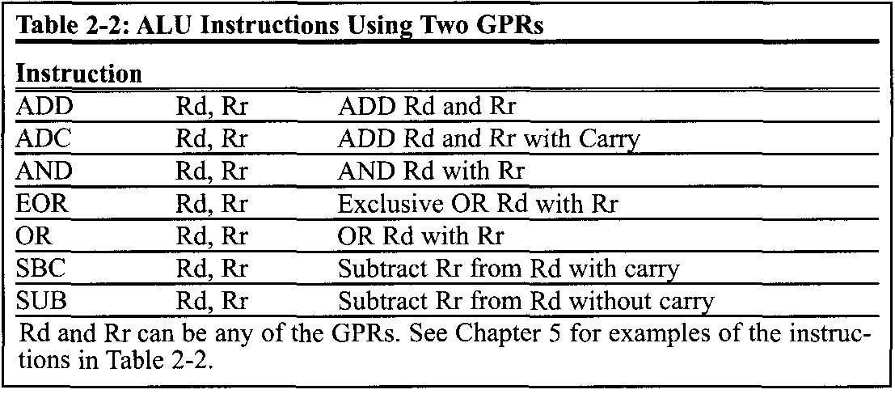
AVR Microcontroller

Slide 3
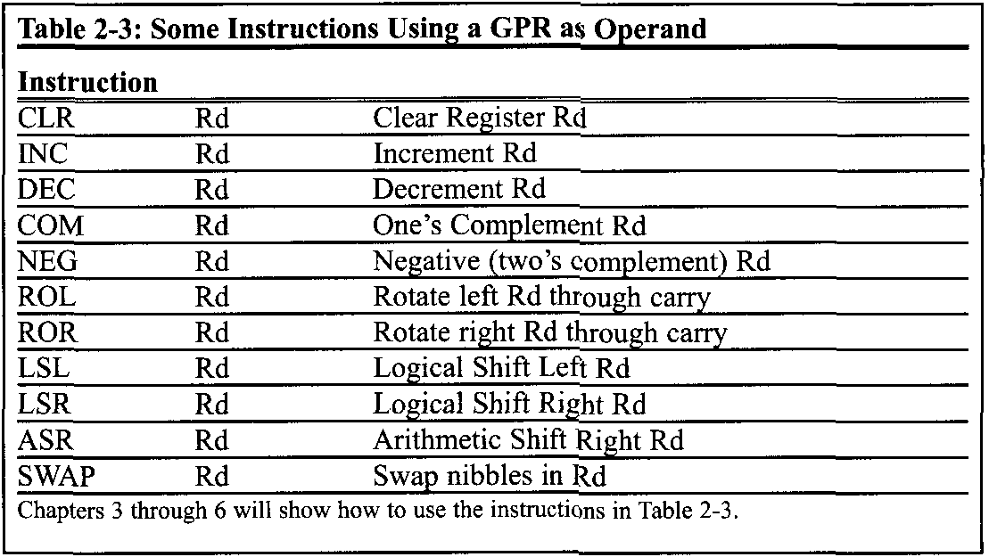
AVR Microcontroller

Slide 4
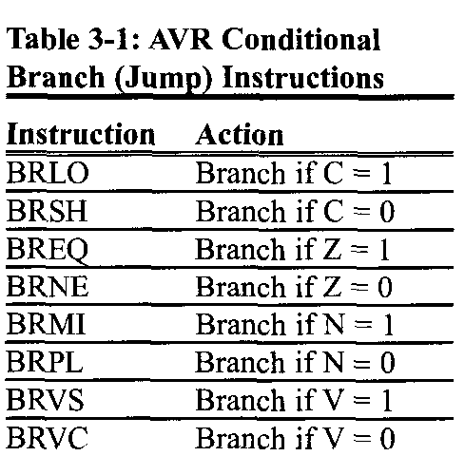
BRANCH, CALL, AND TIME DELAY LOOP
3.1 BRANCH INSTRUCTIONS AND LOOPING
Other conditional jumps
In Table 3-1 you see some of the conditional branches for the AVR. In Table 3-1 notice that the instructions, such as BREQ (Branch if Z = 1) and BRLO (Branch if C = I), jump only if a certain condition is met. Next, we examine some conditional branch instructions with examples.

Slide 5
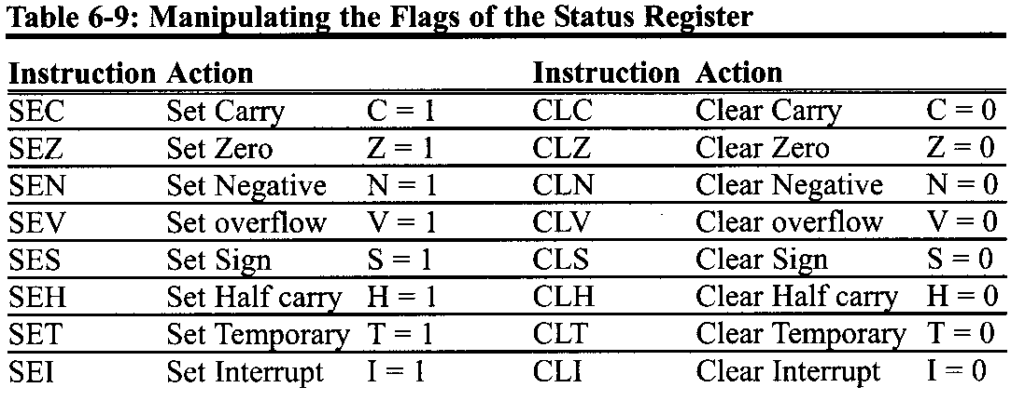
AVR ADVANCED ASSEMBLY LANGUAGE PROGRAMMING
6.5 BIT-ADDRESSABILITY
A more convenient way is to use the CLZ instruction, as shown in Table 6-9.

